Slide 1
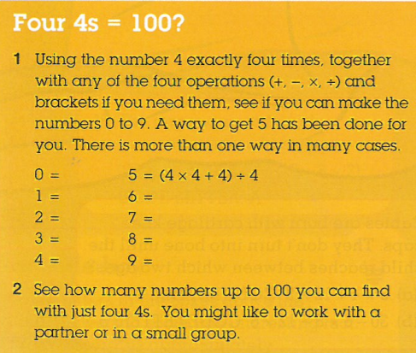
Topic: Integers
EQ: How do I place numbers on a number line?
Get your VIVO’s
Topic and EQ in Interactive Notebook
Tick name off scientific calculator list on white board
Collect Academic Alliance letter if you want
Put the following in your planner:
- PAT testing period 5 tomorrow wait outside the library
  -Logon on to CONNECT and have a look at maths page
  - Logon onto mathspace.co and complete 5 question task
The maths while you are waiting
On your Cornell notes side follow this and DO:

